Slide 1
“The Power of the Force!!!”
Learning to calculate Force, mean, and Newton’s

Slide 2
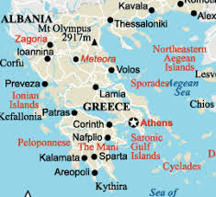
Ancient Greece

Slide 3
Importance of Greece to our lesson
Ancient Greece is the home of early scientist, philosophers, mathematicians, poets and artist
One of the most important mathematicians and natural philosophers was Pythagoras.
He lived from 571 BC till 495 BC
That’s 2500 years ago!

Slide 4
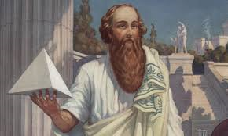
Pythagoras

Slide 5
Pythagoras
Important work
The Pythagorean Theorem
a² + b² = c²
It is used to find the angle of a triangle
Today we will be using it to find the two angels that we are going to be working with today

Slide 6
Example 1
If we have the following
a = 10
b = 5
c = ?
That would be 10² (or 10 times 10)
That would be 5² (or 5 times 5)
This would give us 100 + 25 = 125
0r 125 = c², we then take the square root of both sides (√)
c = 11.18º

Slide 7
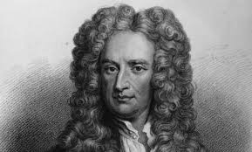
Sir Isaac Newton

Slide 8
Sir Isaac Newton’s Importance
Was Born in 1642 meaning he lived almost 400 years ago
He is responsible for the measurement's known as Newton’s.
He is also responsible for the mathematical way of finding and explaining Force.
His equation for finding force is
Force (F) = Mass(M) times Acceleration (A)

Slide 9
Newton Continued
He also gave us a way to convert grams into Newton's, which is the measurement of weight in physics.
We do this by taking the grams and dividing by 1000. so it looks like this grams/1000
Then we take that number and multiply it by the Earths gravitation standard which is 9.8 m/s²

Slide 10
Example 2: Finding Newton’s
If something has the weight of 20 grams we would do the following to find Newton’s (N)
20/1000 = 0.02
Then we multiply by Earths gravitations constant 9.8m/s²
So 0.02 times 9.8 = 0.196 Newton’s or (N)

Slide 11
Example 3: Calculating “Force”
When calculating Force we use the following equation Force (F) = Mass (m) times Acceleration (a)
So we get F= m· a
If we have a mass of .19 (N) and an acceleration of 2.3 m/s the math looks like this
F= Mass (.19 N) · Acceleration (2.3 m/s) amd we get F = .437 N m/s

Slide 12
Finding the Average or the “MEAN”
When calculating the average or the “MEAN”, MEAN is just a more sciency word for Average, we take all the times we recorded when racing our cars and then divided them by the number of times raced.
So it will look like this
Sum of time taken/number of times raced.

Slide 13
Finishing up our experiment
When we take our measurement's when racing the cars down our ramps, we need to use the rulers on the table to check the distance the cup was pushed back from the original starting place. We then find our Average or “MEAN” of the distance traveled to see which car and which angle allowed for the most force to be witnessed.

